Slide 1

Introduction to Entrepreneurship
Dr. Zunaira Saqib

Slide 2

Week 3: Ideation
Creating and Validating Your Idea

Slide 3

Watch!
Dragon’s Den (Show)
Shark Tank (Show)
The Founder (McDonald)
Blackberry (Story of Blackberry)
The Silicon Valley (A Fictional Show)
The Social Network (Facebook)
The Internship (Google)
The Intern (How start ups work)

Slide 4

The Idea!
Most people are great at coming up with ideas
Using creativity and questions like “What if?”
Imagine ways something can be done differently
Seeing problems and opportunities

Slide 5
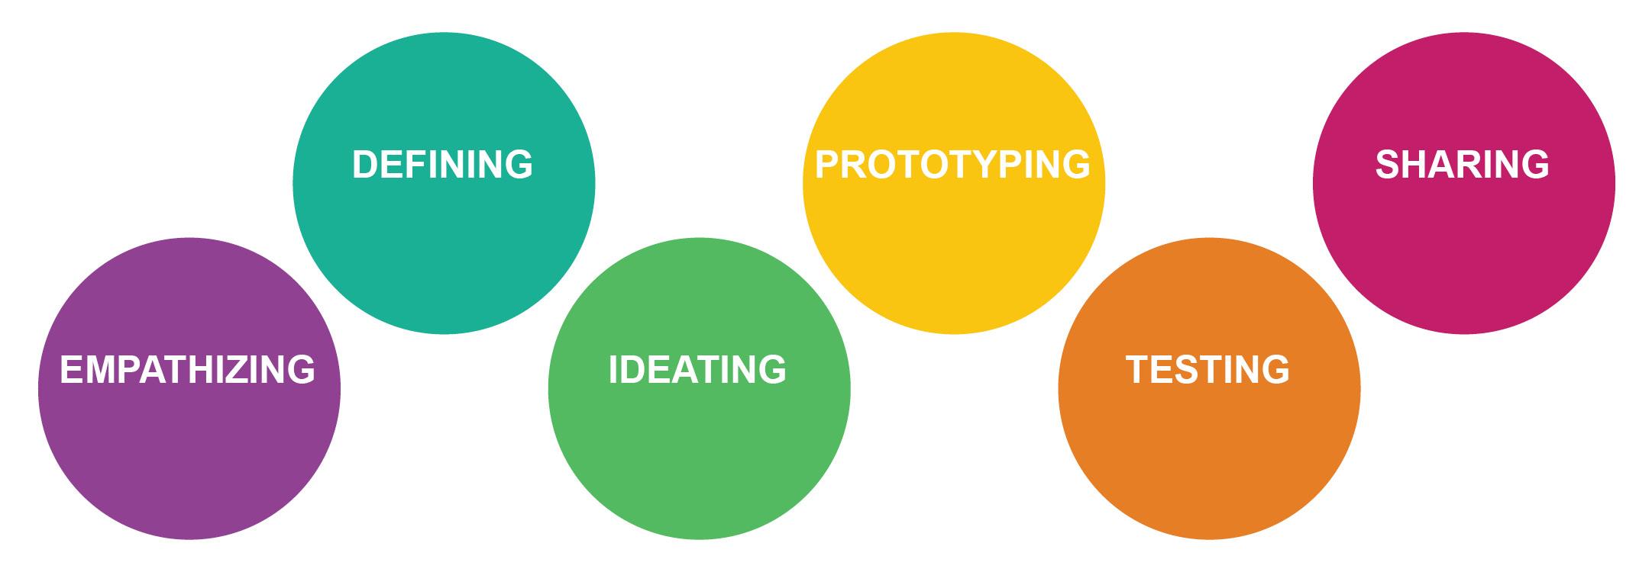
Stanford School of Design Thinking Process

Slide 6

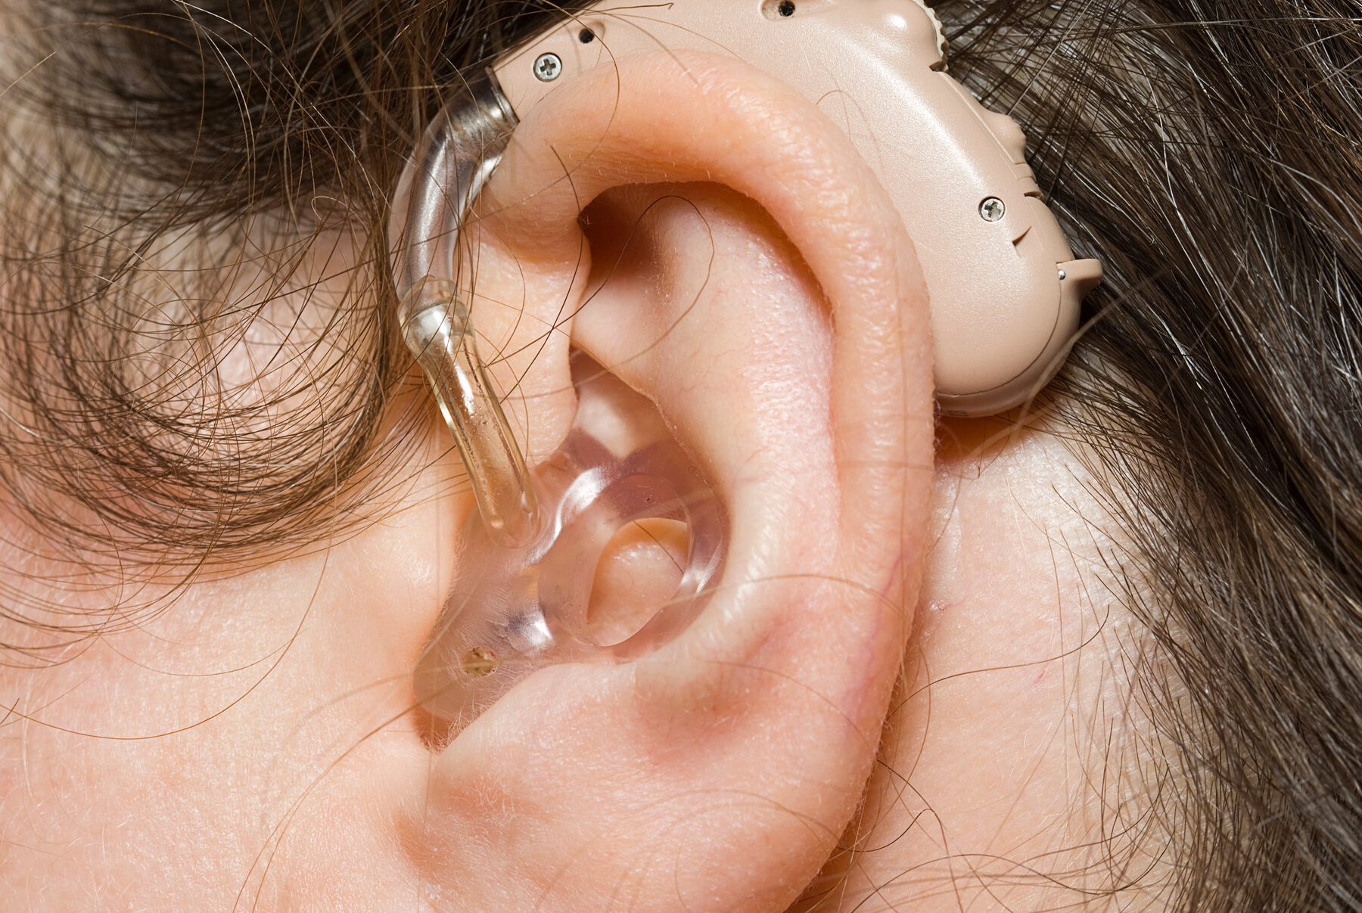
1. Empathizing

Slide 7





Slide 8

1. Empathizing
A problem, that is not your problem, is still a problem.
Gain an empathic understanding of the problem you are trying to solve
Find out more about the area of concern and conduct observations to engage and empathize with your users. Understand their experiences and motivations
Empathy is all about setting aside your own assumptions about the world and gain real insight into users and their needs
Develop the best possible understanding of your users, their needs and the problems that underlie the development of the product or service you want to create

Slide 9

How to Empathize?
Observations
You’ll go where your users go and see what they care about
Qualitative Interviews
You’ll hold one-on-one interviews with a handful of your users to understand their attitudes on the topic you are exploring.
Asking someone to tell a story
https://www.youtube.com/watch?v=t1cYQFuU8Dw&ab_channel=GIRLINPARADISE

Slide 10
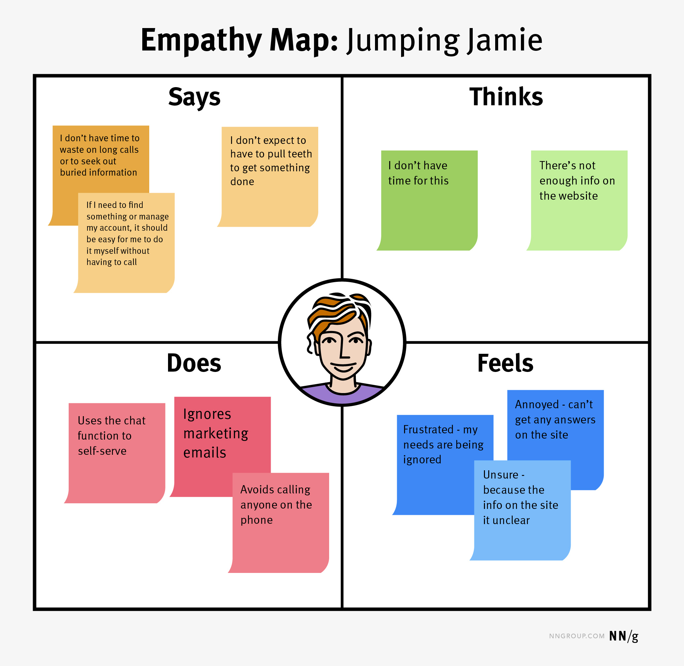
Empathy Maps
Says
Does
Thinks
Feels

Slide 11
Empathy Mapping
What did the user SAY?
Write down significant quotes and key words that the user said.
What did the user DO?
Describe which actions and behaviours you noticed or insert pictures or drawing.
What did the user THINK?
Dig deeper. What do you think that your user might be thinking? What are their motivations, their goals, their needs, their desires? What does this tell you about his or her beliefs?
How did the user FEEL?
What emotions might your user be feeling? Take subtle cues like body language and their choice of words and tone of voice into account.

Slide 12
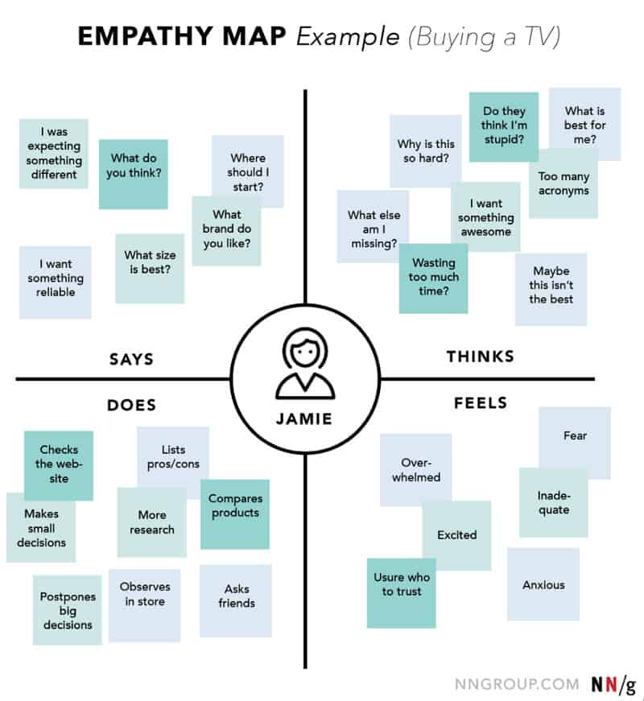

Slide 13

2. Defining
Organize the information you have gathered during the Empathize stage
Analyse your observations to define the core problems
This stage helps collect great ideas to establish features, functions and other elements to solve the problem at hand
Identify user’s pain point
Wrong Problem = Wrong Solution

Slide 14

Defining
Problem Statement
Properly articulate the problem statement
1) What is the problem?
2) Who has the problem?
3) Where is the problem?
4) Why does it matter

Slide 15

Defining
You can’t solve all of your users’ problems. Identify the most significant or most painful issues they face as you consider what you want to focus on as you move forward.

Slide 16
Problem Statements
“Going to the video store is a pain. People don’t like traveling back and forth just to rent a movie and they hate paying late fees even more.”
The average customer service on-hold time for internet companies is exceeding 10 minutes. The customers are angry, companies are understaffed and customer service representatives are overwhelmed.
Distance education via online platforms is a rapidly growing method of education delivery. Regardless of the software used, student attendance at live online sessions, especially optional ones, can be unpredictable at best. It is a common complaint by faculty that their students do not attend the live online sessions.
Travellers want to have cheap and clean accommodations. The home owners have spare rooms which they can rent and make extra money.

Slide 17

3. Ideation
Now that the problem you intend to solve is clear, it’s time to brainstorm ways to address those unmet needs.
You collect as many ideas as possible at the start, so your team can investigate and test them by the end.
Brainstorm potential solutions
Select and develop 1-2
Worst Possible Idea Exercise

Slide 18

Worst Possible Ideas
It allows team members to brainstorm and share their ‘worst ideas’ without fear of judgment or criticism
This fosters an environment where coming up with the “perfect” ideas is eliminated, allowing freedom and creativity to shine.
Come up with as many bad ideas as we can
List what makes the worst of these so very bad
Search for the opposite of the worst attribute
Mix and match various awful ideas to see what happens

Slide 19

How do you know it will work?
Is your proposed solution feasible, both from a market perspective and a technology perspective?
Would your users pay?
Can you compete?
Is there sustainable competitive advantage?
Do we have a team that can effectively capitalize of this opportunity?
What is the risk / reward profile of this opportunity?
Does it justify the investment of time and money?
Is there a sufficiently attractive market opportunity?

Slide 20

Your Business Ideas
Do three stages justify it now?

Slide 21

Final Project
Launching your own product or service in Pakistan.
Come back with your 3 Ideas.
You will present these ideas in class.
Problem Statement
Your Idea
We will do the three stages in next two weeks and shortlist ideas.
The grade of the FP will be divided into
Preliminary Pitches (post midterm)
Final Pitch
Written Submission

